Slide 1
Prediction for Employee Attrition
Project Synopsis Submitted by:
Harshawardhan Yeola
Course and Batch: DSP-9, Bangalore

Slide 2
Table of Contents

Slide 3
Project Objective
Identify factors influencing attrition
Predict possible attritions
Based on the data that is available, we need to build a model to predict attrition probability of an employee. This will help the company to identify employees who have high possibility of quitting and will allow them to allocate resources to combat the issue.
From the data set, the target variable is ‘Current Status’

Slide 4
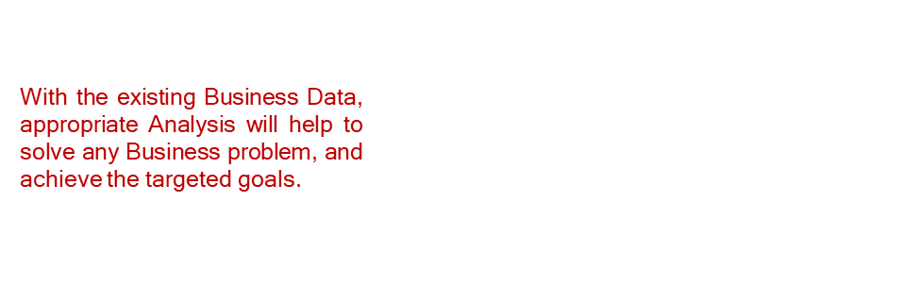
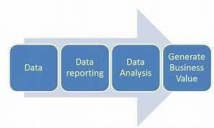
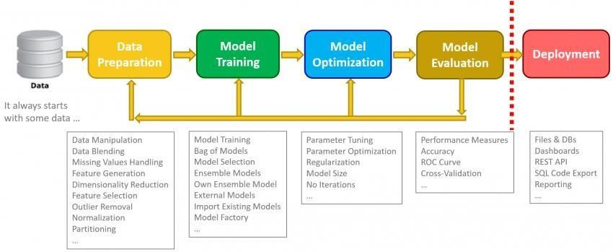
Data Analysis Workflow

Slide 5
Data Pre-processing
We have 2 staff utilization files for year 2016-17 and 2017-18 along with one termination file
We used staff utilization files for prediction model building and termination file for further data exploration
The staff utilization date is in pivot format and not in the time series format. Monthly data has been discarded and we are considering the 'Total' data features for our analysis
New feature 'Tenure' in days has been calculated from joining date and termination date feature
For active employees where termination date is missing , we will be imputing last day of the year (31 March)
We encoded ‘Employee Position’ as Categorical-Ordinal feature
Feature Selection - Filter method
Filter methods pick up the intrinsic properties of the features measured via univariate statistics instead of cross-validation performance. These methods are faster and less computationally expensive than wrapper methods.
Information Gain
Information gain calculates the reduction in entropy from the transformation of a dataset.
It can be used for feature selection by evaluating the Information gain of each variable in the context of the target variable.
Based on the above method -
'Profit Center‘ and 'Employee Location' –features have been removed as no information gain found in these features

Slide 6
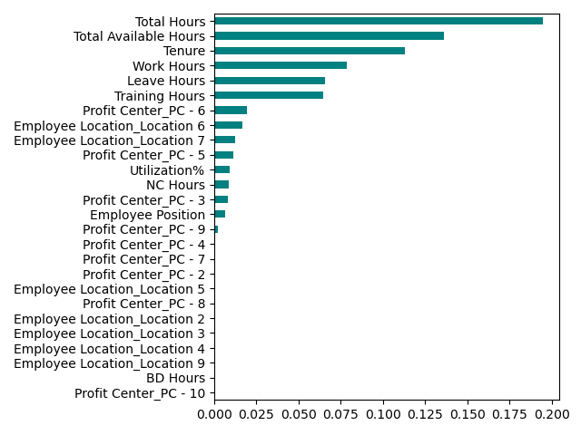
Data Pre-processing
Feature Selection using Information Gain method
8) ‘Supervisor name’ feature has been excluded from the analysis/model building as we cannot handle/encode it with knowledge we possess at this point.

Slide 7
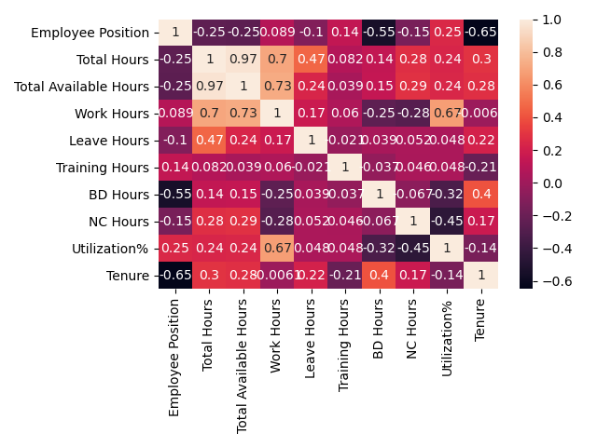
Data Pre-processing
9) Correlation matrix – From numerical features, we removed ‘Total Hours’ and ‘Work Hours’ features as they are redundant features
‘Total Hours’ has close to 100% correlation with ‘Total Available Hours’ and ‘Work Hours’ can be expressed with ‘Total Available Hours’ and ‘Utilization%’

Slide 8
Dataset Summary
After the data preprocessing and feature selection, we are left with –
1 Categorical-Ordinal feature – ‘Employee Position’
8 Numeric features , further undergone StandardScaler
Hence we will be working with 9 independent variables to predict a binary dependent variable
Data for 2016-17 is used for training and 2017-18 is used for testing.
We are not combining the two data files to avoid duplicate entries.
Train dataset - There are total 10 columns and 789 rows present in the data set
Test dataset - There are total 10 columns and 974 rows present in the data set
In the train/test datasets, the dependent variable is “Current Status” to predict.

Slide 9
Model Building
After data cleaning and processing, it is ready for building different models for prediction. Model building is the process of developing a probabilistic model that best describes the relationship between the dependent and independent variables.
Three different models are being developed to predict the values. They are:
Logistic Regression:
Logistic regression is a supervised learning classification algorithm used to predict the probability of a target variable. Generally, logistic regression means binary logistic regression having binary target variables, but there can be two more categories of target variables that can be predicted by it, named as Multinomial Logistic Regression.
K-Nearest Neighbor (KNN)
The k-nearest neighbors (KNN) algorithm is a simple, easy-to-implement supervised machine learning algorithm that can be used to solve both classification and regression problems. KNN is non-parametric algorithm.
However it is not a good choice for our problem
Random Forest Model
Random forest is a tree-based algorithm which involves building several trees (decision trees), then combining their output to improve generalization ability of the model. The method of combining trees is known as an ensemble method.
Random forest looks a good choice for our problem

Slide 10
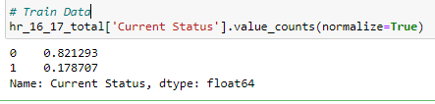
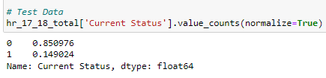
Handling Imbalanced Dataset
Technique to handle imbalanced dataset
The provided dataset is highly imbalanced with majority class is Current Status = ‘Active’
One approach to addressing imbalanced datasets is to oversample the minority class. This approach involves duplicating examples in the minority class, although these examples don’t add any new information to the model. Instead, new examples can be synthesized from the existing examples. It is referred to as the Synthetic Minority Oversampling Technique, or SMOTE for short.

Slide 11
Tuning Hyper-parameters for Random Forest
Hyper Parameter Tuning of model:
GridsearchCV is done to find the best parametric values. After input of the optimum parameter values in the Random Forest model, accuracy improves along with the other indicators of the model.

